Slide 1
Confidence Intervals
for a Proportion

Slide 2


Interval Estimation
Using only a sample statistic to estimate a parameter is like fishing in a murky lake with a spear, and using an interval estimation is like fishing with a net.
We can throw a spear where we saw a fish but we will probably miss. If we toss a net in that area, we have a good chance of catching the fish.
If we report a point estimate, we probably won't hit the exact population parameter. If we report a range of plausible values we have a good shot at capturing the parameter.
Photos by Mark Fischer (http://www.flickr.com/photos/fischerfotos/7439791462)
and Chris Penny (http://www.flickr.com/photos/clearlydived/7029109617) on Flickr.

Slide 3
Facebook’s categorization of user interests
Most commercial websites collect a data about their users’ behaviors and use these data to deliver targeted content, recommendations, and ads. To understand whether Americans think their lives line up with how the algorithm-driven classification systems categorizes them, a research asked a random sample of 850 American Facebook users how accurately they feel the list of categories Facebook has listed for them on the page of their supposed interests actually represents them and their interests. 67% of the respondents said that the listed categories were accurate.
Goal: Estimate the true proportion of American Facebook users who think the Facebook categorizes their interests accurately.
https://www.pewinternet.org/2019/01/16/facebook-algorithms-and-personal-data/

Slide 4
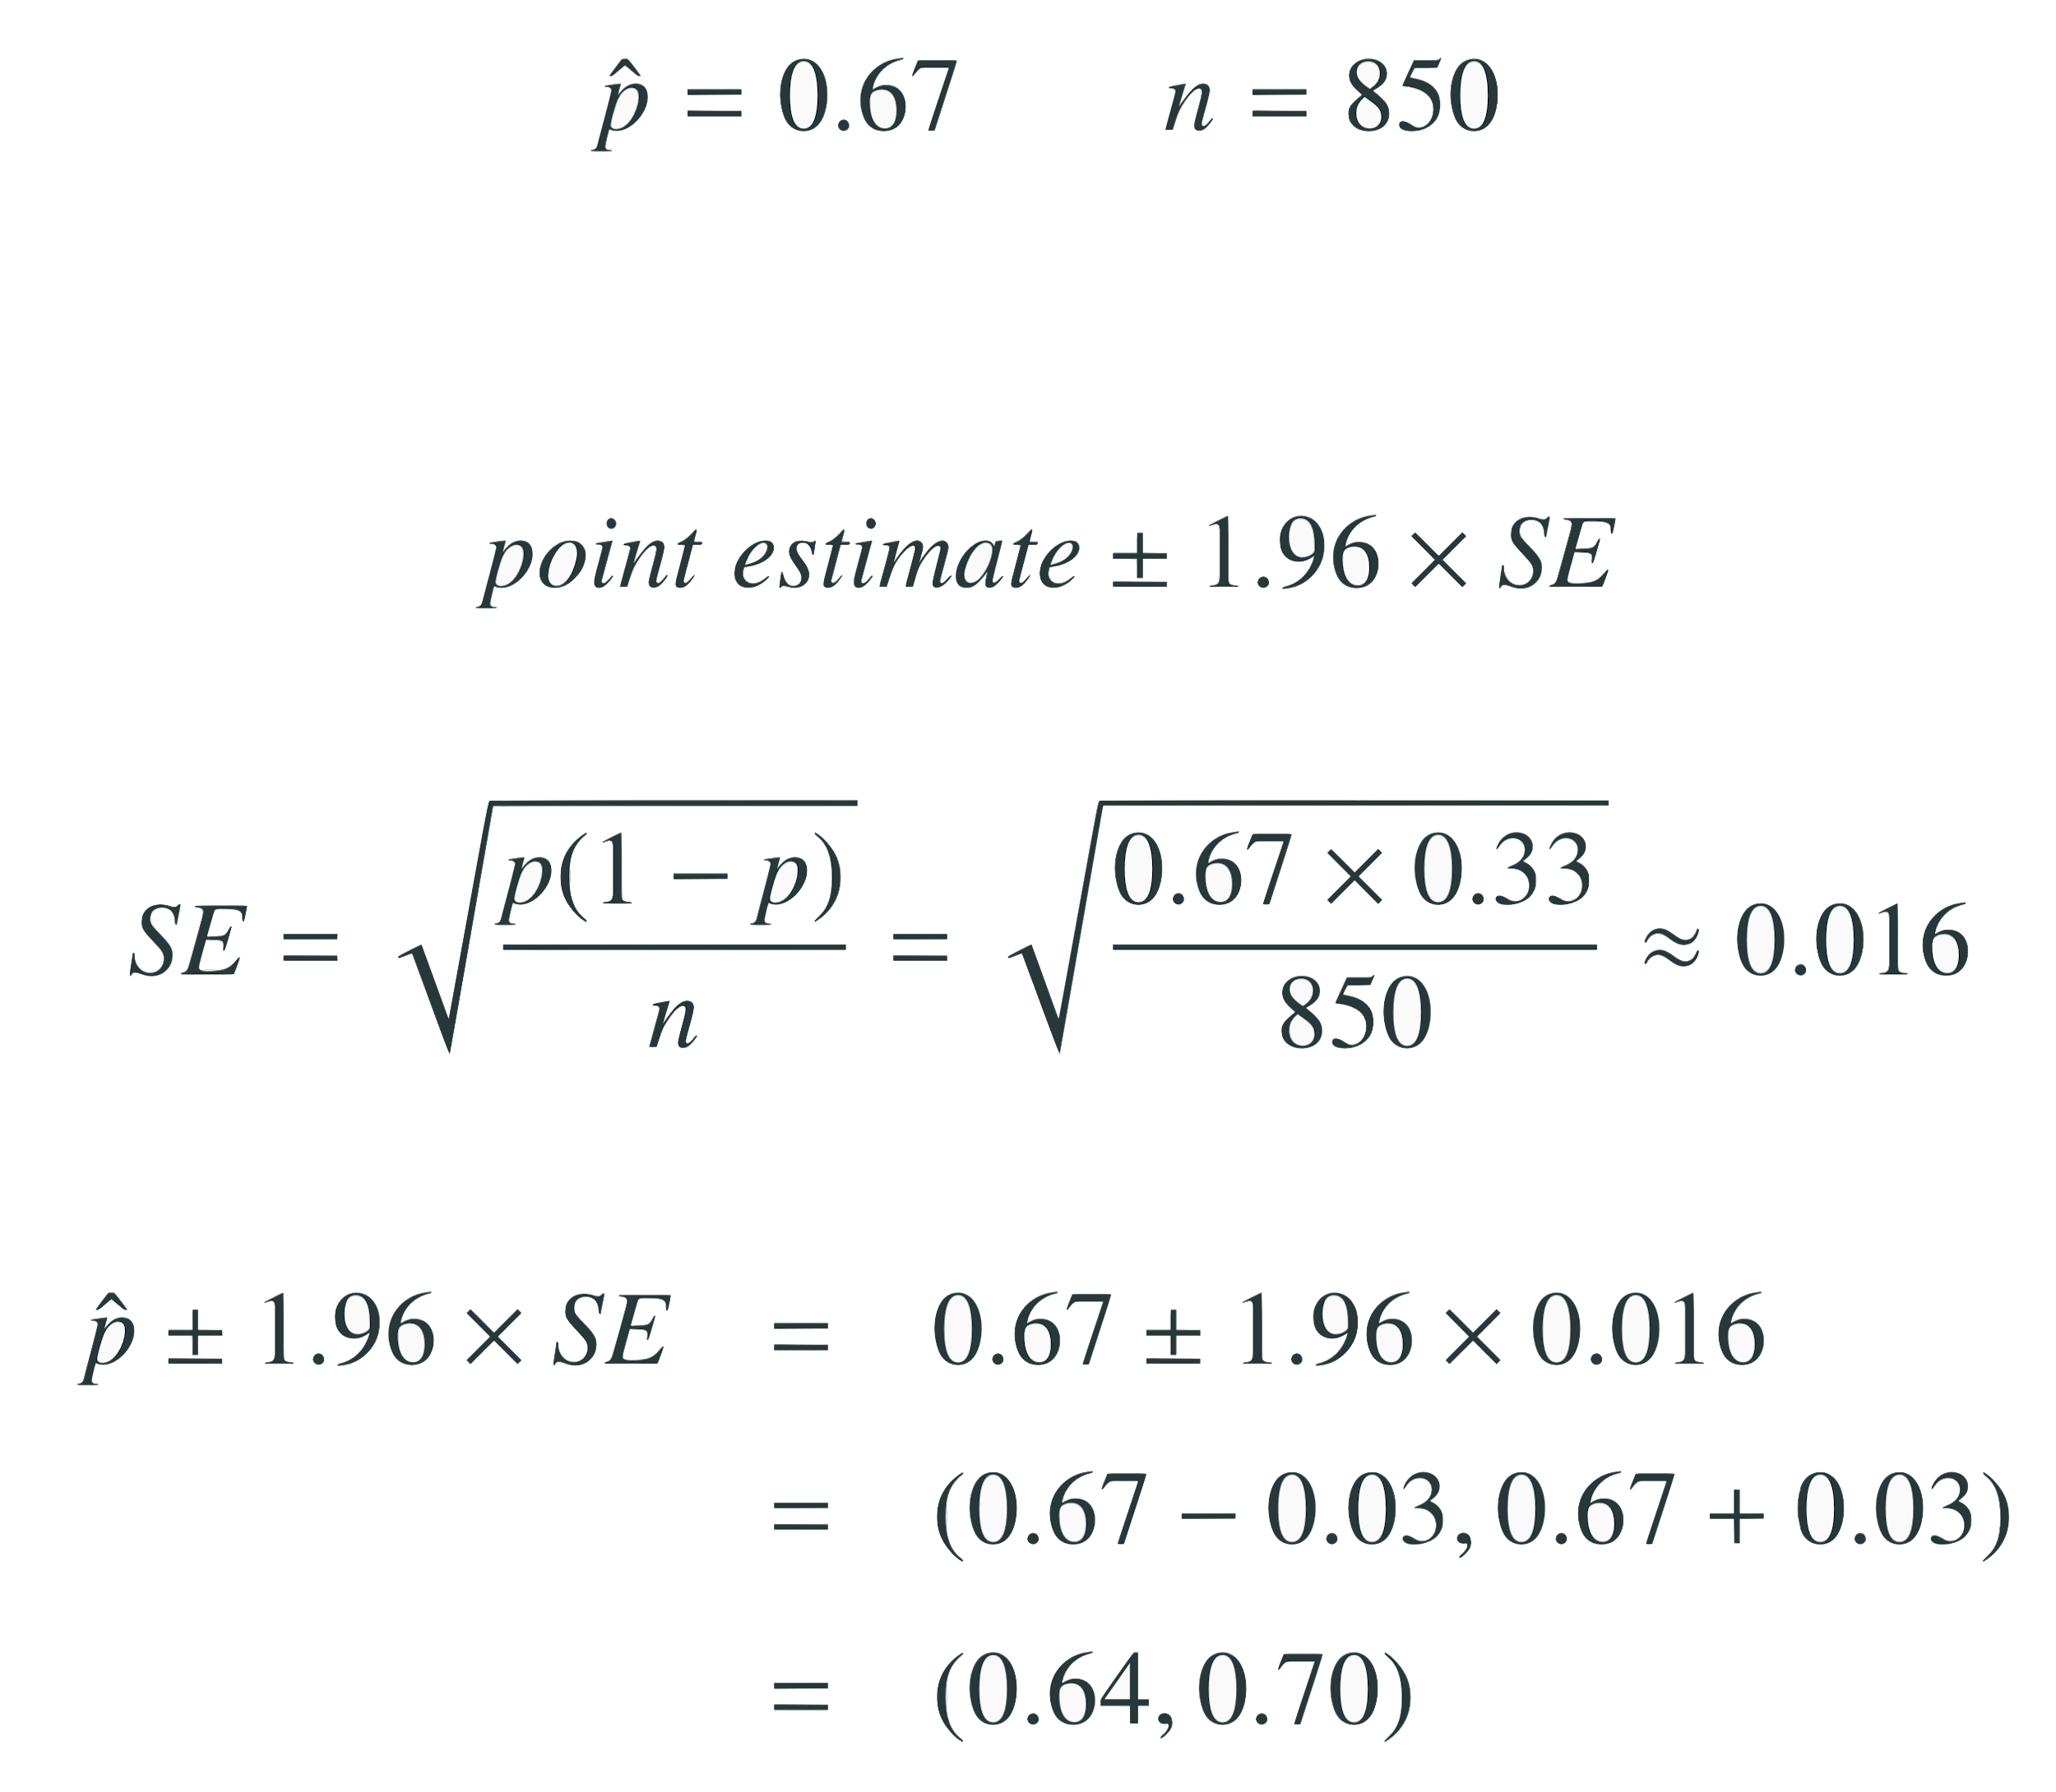
Facebook’s categorization of user interests
About 67% of all American Facebook users think Facebook categorizes their interests accurately
We, to some extent, believe that 64% to 70% of all American Facebook users think Facebook categorizes their interests accurately.

Slide 5
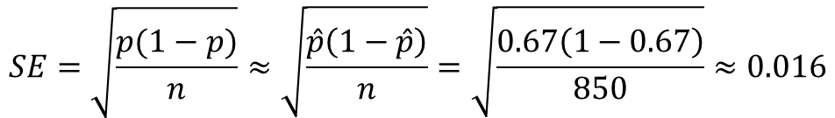
Facebook’s categorization of user interests
The approximate 95% confidence interval for $p$is defined as
$$SE=\sqrt{\frac{p(1−p)}{n}}≈\sqrt{\frac{\hat{p}\left(1−\hat{p}\right)}{n}}=\sqrt{\frac{0.67\left(1−0.67\right)}{850}}≈0.016$$

Slide 6
Facebook’s categorization of user interests
Which of the following is the correct interpretation of this confidence interval? We are 95% confident that...
64% to 70% of American Facebook users in this sample think Facebook categorizes their interests accurately.
64% to 70% of all American Facebook users think Facebook categorizes their interests accurately.
there is a 64% to 70% chance that a randomly chosen American Facebook user’s interests are categorized accurately.
there is a 64% to 70% chance that 95% of American Facebook users’ interests are categorized accurately.

Slide 7
Facebook’s categorization of user interests
Which of the following is the correct interpretation of this confidence interval? We are 95% confident that...
64% to 70% of American Facebook users in this sample think Facebook categorizes their interests accurately.
64% to 70% of all American Facebook users think Facebook categorizes their interests accurately
there is a 64% to 70% chance that a randomly chosen American Facebook user’s interests are categorized accurately.
there is a 64% to 70% chance that 95% of American Facebook users’ interests are categorized accurately.

Slide 8
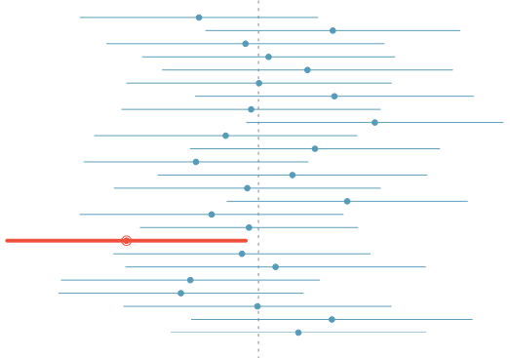
What does 95% mean?
Suppose we took many samples and built a confidence interval from each sample using the equation point estimate ± 1.96 × SE.
Then about 95% of those intervals would contain the true population parameter.

Slide 9
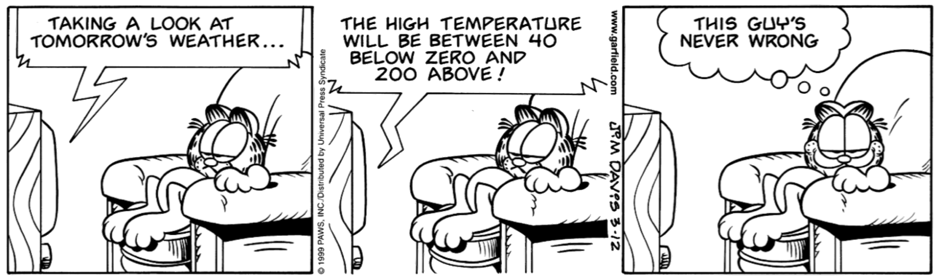
Width of an interval
If we want to be more certain that we capture the population parameter, i.e. increase our confidence level, should we use a wider interval or a smaller interval?
A wider interval.
Can you see any drawbacks to using a wider interval?
If the interval is too wide it may not be very informative.

Slide 10
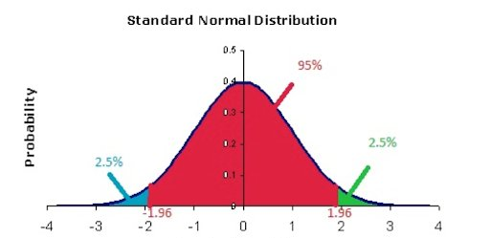
95%: confidence level
point estimate ± margin of error
point estimate ± 1.96 × SE
The most commonly used confidence level in practice is 95%.
For a 95% confidence interval, z★ = 1.96.

Slide 11
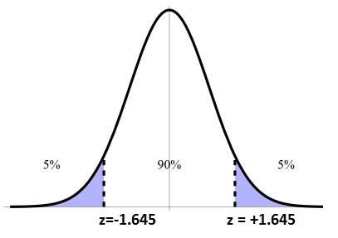
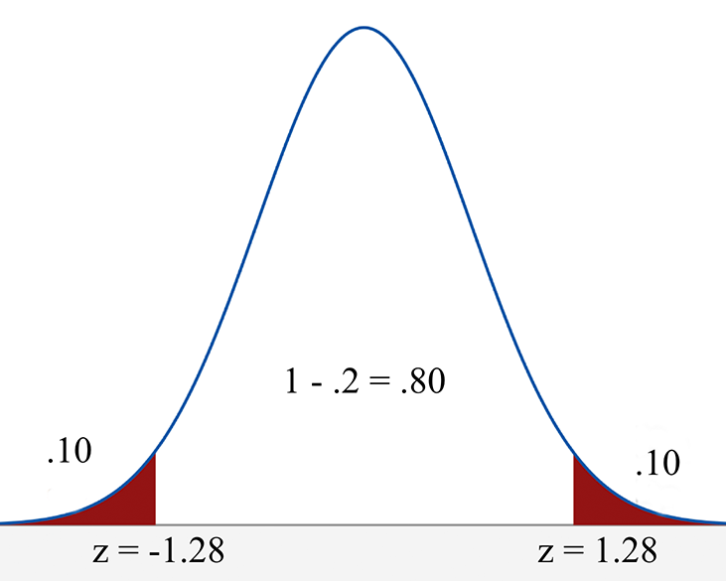
Changing the confidence level
point estimate ± margin of error
point estimate ± z★ × SE
In a confidence interval, z★ × SE is called the margin of error.
When you change the confidence level, z★ will be adjusted in the above formula.

Slide 12
Which of the below Z scores is the appropriate z⋆ when calculating a 98% confidence interval?
(a) Z = 2.05
(b) Z = 1.96
(c) Z = 2.33
(d) Z = 1.645

Slide 13
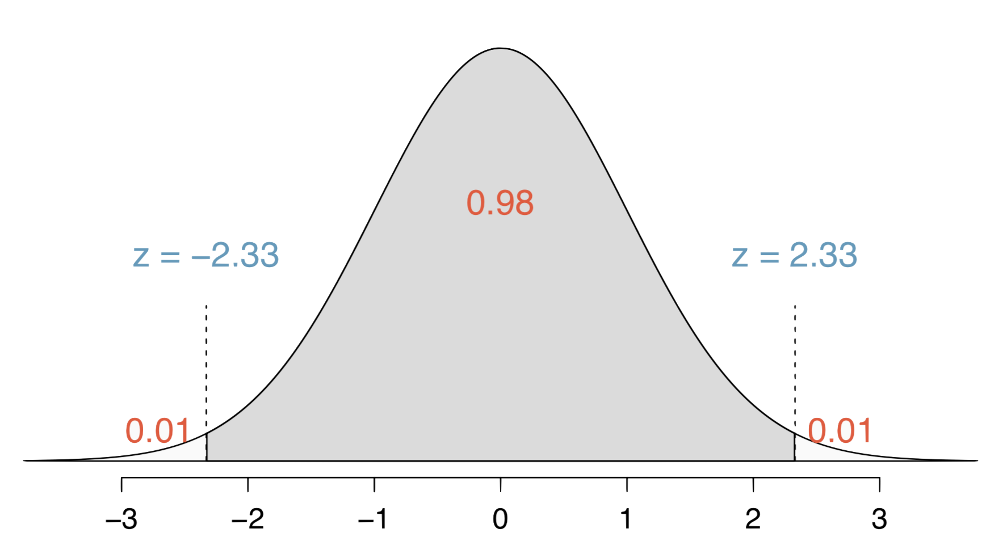
Which of the below Z scores is the appropriate z⋆ when calculating a 98% confidence interval?
(a) Z = 2.05
(b) Z = 1.96
(c) Z = 2.33
(d) Z = 1.645

Slide 14
Confidence Intervals
for a Mean

Slide 15
Average number of exclusive relationships
A random sample of 50 college students were asked how many exclusive relationships they have been in so far. This sample yielded a mean of 3.2 and a standard deviation of 1.74. Estimate the true average number of exclusive relationships using this sample.

Slide 16
Average number of exclusive relationships
A random sample of 50 college students were asked how many exclusive relationships they have been in so far. This sample yielded a mean of 3.2 and a standard deviation of 1.74. Estimate the true average number of exclusive relationships using this sample.
The approximate 95% confidence interval for µ is
point estimate ± 1.96 x SE

Slide 17

Average number of exclusive relationships
A random sample of 50 college students were asked how many exclusive relationships they have been in so far. This sample yielded a mean of 3.2 and a standard deviation of 1.74. Estimate the true average number of exclusive relationships using this sample.
The approximate 95% confidence interval for µ is
point estimate ± 1.96 x SE
$SE=\frac{σ}{\sqrt{n}}≈\frac{s}{\sqrt{n}}=\frac{1.74}{\sqrt{50}}≈$0.25

Slide 18

Average number of exclusive relationships
A random sample of 50 college students were asked how many exclusive relationships they have been in so far. This sample yielded a mean of 3.2 and a standard deviation of 1.74. Estimate the true average number of exclusive relationships using this sample.
The approximate 95% confidence interval for µ is
point estimate ± 1.96 x SE
95% confidence interval for µ is 3.2 ± 1.96 x 0.25 = (2.71, 3.69)
$SE=\frac{σ}{\sqrt{n}}≈\frac{s}{\sqrt{n}}=\frac{1.74}{\sqrt{50}}≈$0.25

Slide 19
Average number of exclusive relationships
A random sample of 50 college students were asked how many exclusive relationships they have been in so far. This sample yielded a mean of 3.2 and a standard deviation of 1.74. Estimate the true average number of exclusive relationships using this sample.
The approximate 95% confidence interval for µ is
point estimate ± 1.96 x SE
95% confidence interval for µ is 3.2 ± 1.96 x 0.25 = (2.71, 3.69)
We’re 95% confident that the average number of exclusive relationships of all college students is between 2.71 and 3.69.
$SE=\frac{σ}{\sqrt{n}}≈\frac{s}{\sqrt{n}}=\frac{1.74}{\sqrt{50}}≈$0.25

Slide 20
Conditions
Confidence interval, a general formula
point estimate ± z* x SE
Conditions:
Independence
Sample size / skew

